Slide 1


CHECKINVISION
Face Recognition Based Attendance System

Slide 2



OUR GROUP
A SRISHANTH
A INDU SREE
B KOUSHIK
22H51A0403
22H51A0401
22H51A0402

Slide 3
INTRODUCTION
Face Recognition Based Attendance System using the ESP32 CAM Module, OpenCV, and Python. The system uses a computer or Raspberry Pi as the server to process face detection, while the ESP32 CAM captures the images. It not only identifies individuals but also records their attendance and the duration they remain in the frame, saving the data in an Excel sheet. The process includes programming the ESP32 CAM with the FTDI module, setting up the Arduino IDE, uploading firmware, and implementing the face recognition algorithm in Python.

Slide 4


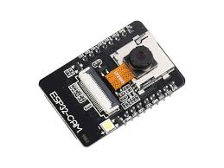
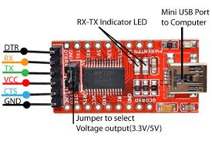
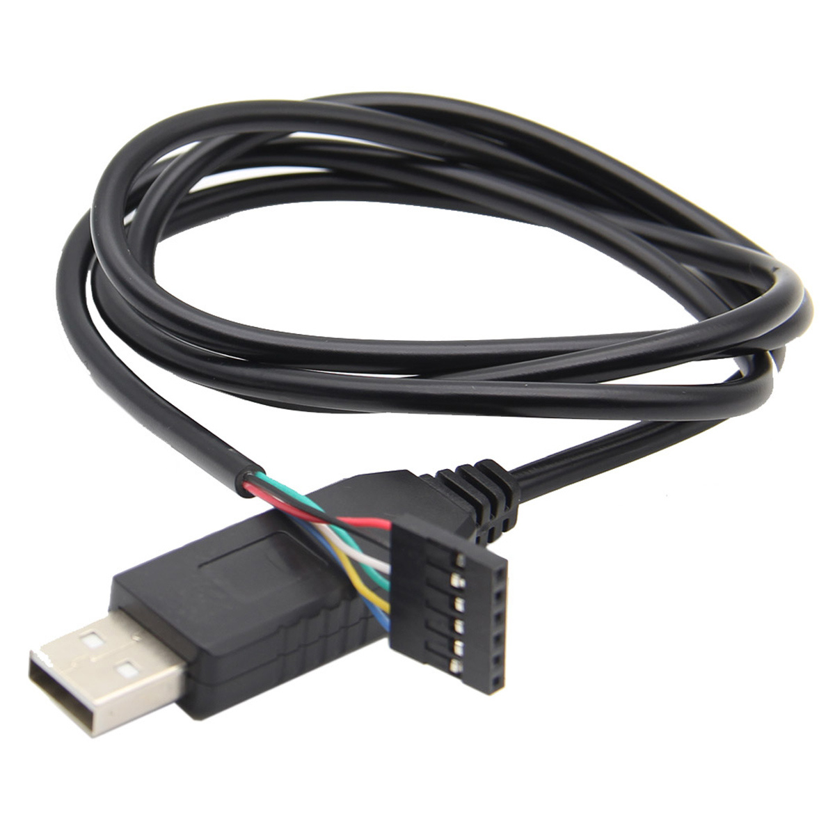



COMPONENTS
HARDWARE
ESP32 CAM Module: Captures images and processes face recognition.
FTDI USB-to-Serial Module: Programs the ESP32 CAM via serial communication.
Jumper Wires: Used for making connections between components.
Breadboard: For prototyping and connecting components.
Micro USB Cable: Powers the FTDI module and ESP32 CAM during programming.
Power Supply (5V): Provides power to the ESP32 CAM during operation.
Computer or Raspberry Pi: Acts as the server to run face recognition and manage data.

Slide 5







SOFTWARE
Arduino IDE :Used to program the ESP32 CAM module and upload firmware.
Python :The programming language for implementing face recognition and managing the system.
OpenCV :A library for image processing and face detection.
Visual Studio :An IDE for writing and running Python scripts, especially for face recognition.
Pandas :A Python library for managing and saving attendance data in Excel files.
Numpy :A library required by OpenCV for numerical operations during image processing.

Slide 6
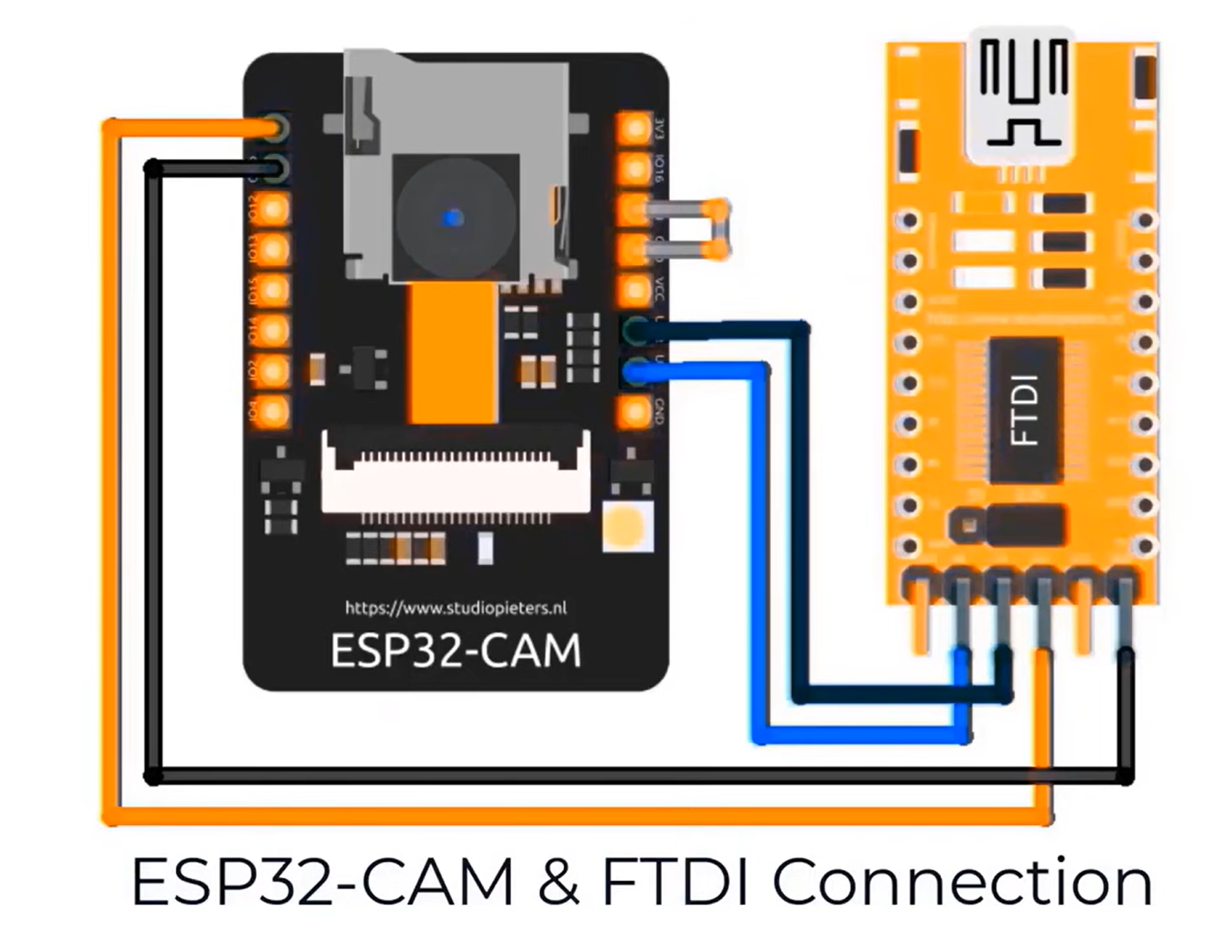
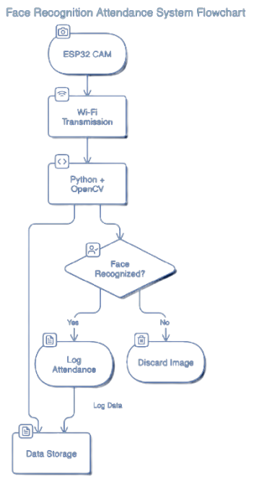
BLOCK DIAGRAM
The Title
You can describe the topic of the section here

Slide 7
SOFTWARE CODE
serveJpg();
}
void handleJpgMid()
{
if (!esp32cam::Camera.changeResolution(midRes)) {
Serial.println("SET-MID-RES FAIL");
}
serveJpg();
}
void setup(){
Serial.begin(115200);
Serial.println();
{
using namespace esp32cam;
Config cfg;
cfg.setPins(pins::AiThinker);
cfg.setResolution(hiRes);
cfg.setBufferCount(2);
cfg.setJpeg(80);
bool ok = Camera.begin(cfg);
Serial.println(ok ? "CAMERA OK" : "CAMERA FAIL");
}
WiFi.persistent(false);
WiFi.mode(WIFI_STA);
WiFi.begin(WIFI_SSID, WIFI_PASS);
while (WiFi.status() != WL_CONNECTED) {
delay(500);
}
Serial.print("http://");
Serial.println(WiFi.localIP());
Serial.println(" /cam-lo.jpg");
Serial.println(" /cam-hi.jpg");
Serial.println(" /cam-mid.jpg");
server.on("/cam-lo.jpg", handleJpgLo);
server.on("/cam-hi.jpg", handleJpgHi);
server.on("/cam-mid.jpg", handleJpgMid);
server.begin();
}
void loop()
{
server.handleClient();
}
#include <WebServer.h>
#include <WiFi.h>
#include <esp32cam.h>
const char* WIFI_SSID = "ssid";
const char* WIFI_PASS = "password";
WebServer server(80);
static auto loRes = esp32cam::Resolution::find(320, 240);
static auto midRes = esp32cam::Resolution::find(350, 530);
static auto hiRes = esp32cam::Resolution::find(800, 600);
void serveJpg()
{
auto frame = esp32cam::capture();
if (frame == nullptr) {
Serial.println("CAPTURE FAIL");
server.send(503, "", "");
return;
}
Serial.printf("CAPTURE OK %dx%d %db\n", frame->getWidth(), frame->getHeight(),
static_cast<int>(frame->size()));
server.setContentLength(frame->size());
server.send(200, "image/jpeg");
WiFiClient client = server.client();
frame->writeTo(client);
}
void handleJpgLo()
{
if (!esp32cam::Camera.changeResolution(loRes)) {
Serial.println("SET-LO-RES FAIL");
}
serveJpg();
}
void handleJpgHi()
{
if (!esp32cam::Camera.changeResolution(hiRes)) {
Serial.println("SET-HI-RES FAIL");
}

Slide 8
PYTHON CODE
import pandas as pd
import cv2
import urllib.request
import numpy as np
import os
from datetime import datetime
import face_recognition
path = r'D:\python\attendace\attendace\image_folder'
url='http://192.168.231.162/cam-hi.jpg'
##'''cam.bmp / cam-lo.jpg /cam-hi.jpg / cam.mjpeg '''
if 'Attendance.csv' in os.listdir(os.path.join(os.getcwd(),'attendace')):
print("there iss..")
os.remove("Attendance.csv")
else:
df=pd.DataFrame(list())
df.to_csv("Attendance.csv")
images = []
classNames = []
myList = os.listdir(path)
print(myList)
for cl in myList:
curImg = cv2.imread(f'{path}/{cl}')
images.append(curImg)
classNames.append(os.path.splitext(cl)[0])
print(classNames)
def findEncodings(images):
encodeList = []
for img in images:
img = cv2.cvtColor(img, cv2.COLOR_BGR2RGB)
encode = face_recognition.face_encodings(img)[0]
encodeList.append(encode)
return encodeList
def markAttendance(name):
with open("Attendance.csv", 'r+') as f:
myDataList = f.readlines()
nameList = []
for line in myDataList:
entry = line.split(',')
nameList.append(entry[0])
if name not in nameList:
now = datetime.now()
dtString = now.strftime('%H:%M:%S')
f.writelines(f'\n{name},{dtString}')
encodeListKnown = findEncodings(images)
print('Encoding Complete')
#cap = cv2.VideoCapture(0)
while True:
#success, img = cap.read()
img_resp=urllib.request.urlopen(url)
imgnp=np.array(bytearray(img_resp.read()),dtype=np.uint8)
img=cv2.imdecode(imgnp,-1)
# img = captureScreen()
imgS = cv2.resize(img, (0, 0), None, 0.25, 0.25)
imgS = cv2.cvtColor(imgS, cv2.COLOR_BGR2RGB)
facesCurFrame = face_recognition.face_locations(imgS)
encodesCurFrame = face_recognition.face_encodings(imgS, facesCurFrame)
for encodeFace, faceLoc in zip(encodesCurFrame, facesCurFrame):
matches = face_recognition.compare_faces(encodeListKnown, encodeFace)
faceDis = face_recognition.face_distance(encodeListKnown, encodeFace)
# print(faceDis)
matchIndex = np.argmin(faceDis)
if matches[matchIndex]:
name = classNames[matchIndex].upper()
# print(name)
y1, x2, y2, x1 = faceLoc
y1, x2, y2, x1 = y1 * 4, x2 * 4, y2 * 4, x1 * 4
cv2.rectangle(img, (x1, y1), (x2, y2), (0, 255, 0), 2)
cv2.rectangle(img, (x1, y2 - 35), (x2, y2), (0, 255, 0), cv2.FILLED)
cv2.putText(img, name, (x1 + 6, y2 - 6), cv2.FONT_HERSHEY_COMPLEX, 1, (255, 255, 255), 2)
markAttendance(name)
cv2.imshow('Webcam', img)
key=cv2.waitKey(5)
if key==ord('q'):
break
cv2.destroyAllWindows()
cv2.imread

Slide 9
APPLICATIONS
Educational Institutions: Automation
Workplace Attendance Management: Security
Event Management: Efficiency
Security Systems: Access
Healthcare: Monitoring
Public Services: Tracking

Slide 10

JUSTIFICATION
.
This IoT attendance system offers real-time data processing, remote access, and scalability:
Real-Time: ESP32 CAM captures, processes, and logs attendance instantly.
Remote Access: Wi-Fi-enabled for data access across locations.
Scalability: Easily expandable with additional ESP32 CAMs for wider coverage.
With automation, data analysis, and network growth potential, it’s an advanced solution for attendance and monitoring.

Slide 11
CONCLUSION
This project highlights the transformative impact of facial recognition-based automation across sectors. By enhancing security, efficiency, and management, it offers innovative solutions for educational, workplace, healthcare, and public service settings, paving the way for smarter, streamlined operations.

Slide 12
THANK YOU

